Slide 1
3D Shapes
By: John Roda, Mike Minogue, Patrick Gaudet

Slide 2
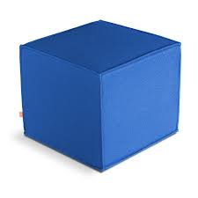
A Square Printer
All of this sides on the square printer equal 15 in.
V=15x15x15
V=225x15
V=3375
Volume is…
3375in.^3

Slide 3
An iPad
The lengths of the iPad are 7.5in., 8.5in., and 2.5in.
V=7.5x8.5x2.5
V=63.75x2.5
V=159.4
Volume is…
159.4in.^3

Slide 4
Cake Box
All of the sides are 8in. On the cake box(rectangle in picture, cube in reality)
V=8x8x8
V=64x8
V=512
Volume is…
512in.^3

Slide 5
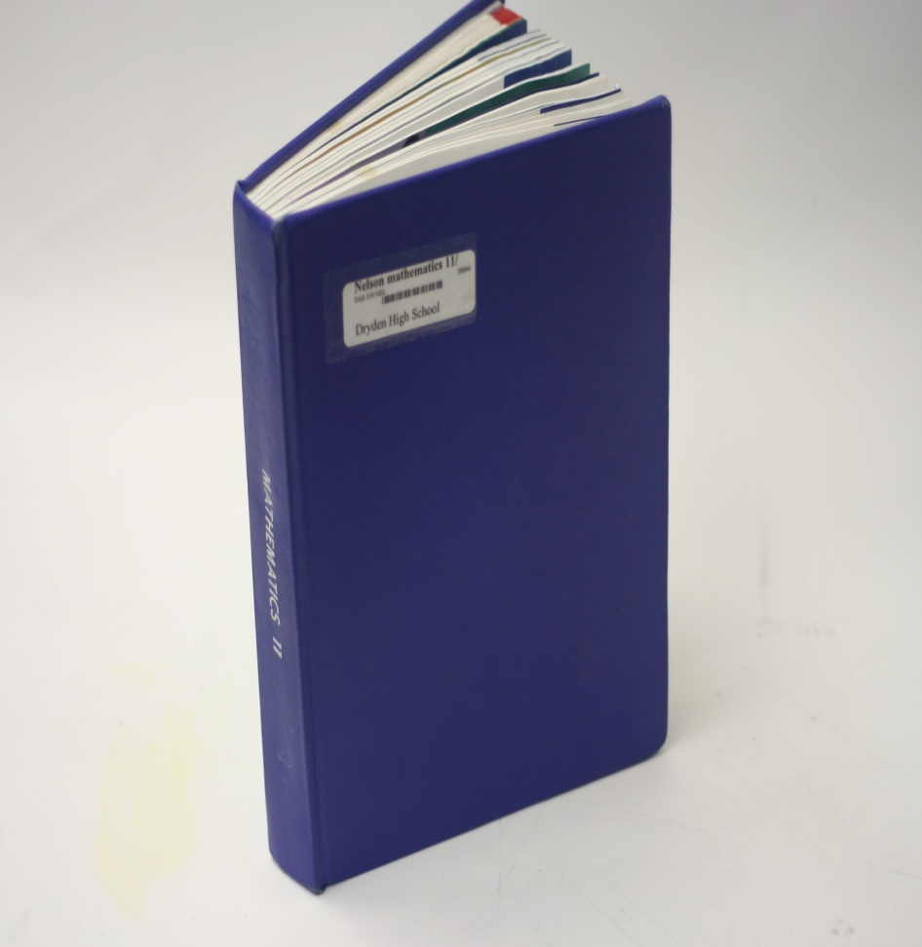
The lengths of this textbook are 8.5in., 11in., and 1in.
V=8.5x11x1
V=93.5x1
V=93.5
Volume is…
93.5in.^3

Slide 6
Tissue Box
All of the lengths are 5.5in. on the Tissue Box
V=5.5x5.5x5.5
V=30.25x5.5
V=166.4
Volume is…
166.4in.^3

Slide 7
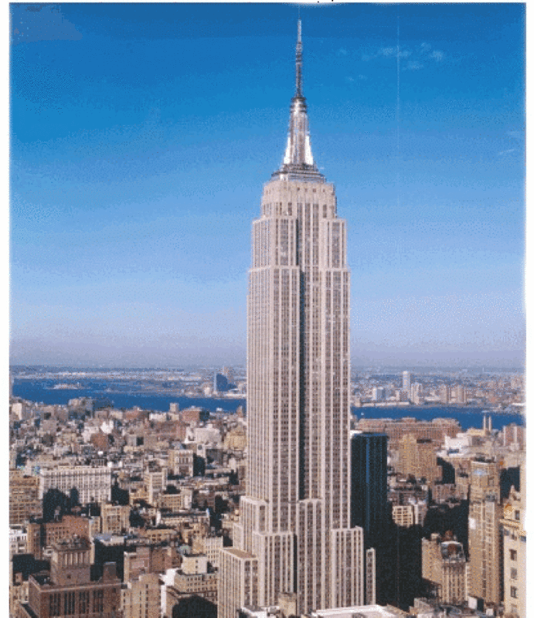
Empire State Building
All of the lengths are 1250ft., 295ft., and 295ft.
V=1250x295x295
V=368750x295
V=108781250
Volume is…
108781250ft.^3

Slide 8
Paper Towel Roll
The radius is 2.5 in. and the height is 11in.
V=3.14x5x11
V=15.7x11
V=172.7
Volume is…
172.7in.^3

Slide 9
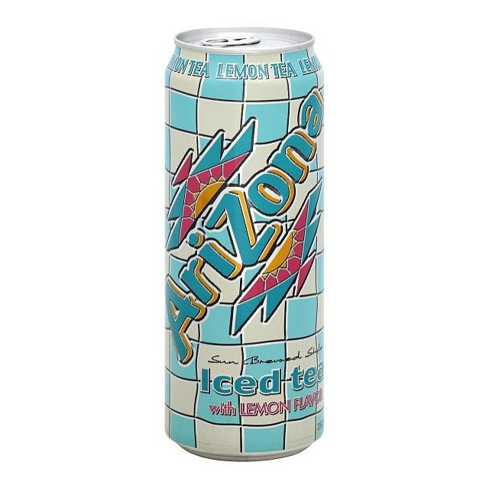
Arizona Can
The radius is 1in. And the height is 5in.
V=3.14x2x5
V=6.28x5
V=31.40
Volume is…
3140in.^3

Slide 10
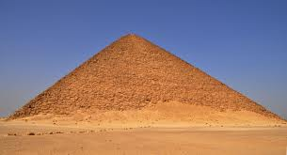
The Pyramids of Giza
Height 1 is 230.4m the length of the base is 138.8m and height 2 is 138.8m.
V=138.8x138.8/2x230.4/3
V=9632.72x230.4/3
V=2219378.688/3
V=739792.896
Volume is…
739792.9m^3

Slide 11
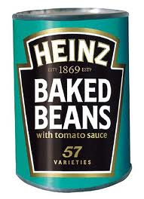
Can of Beans
Height is 25cm and the Radius is 5cm.
V=3.14x25^2x5
V=1962.5x5
V=9812.5
Volume is…
9812.5cm^3

