Slide 1
Dimensions of the World
By: Katarina Rikic

Slide 2
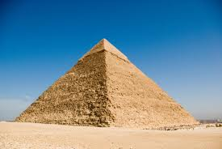

Slide 3
The Pyramid of Giza
Pyramid of Giza:
Base = 230.4 meters
Height= 146.5 meters
Formula – (1/3)bh
(1/3)230.4m x 146.5m = 11251.2 meters cubed

Slide 4
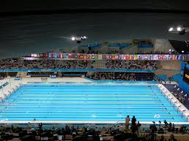

Slide 5
Olympic Swimming Pool
Base edge=2 meters
Base height=25 meters
Height=50 meters
Work: 2x 25x 50=
2500 meters cubed

Slide 6
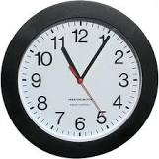

Slide 7
School ClockClock
Height= 5cm
Radius=30cm
Work= (30x30)x 3.14x 5=
14,130 cm cubed

Slide 8
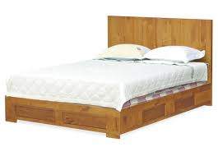

Slide 9
Queen Bed
Height=30 inches
Length= 80inches
Width=60 inches
Work= 30x 60x 80=
14,400 inches cubed

Slide 10
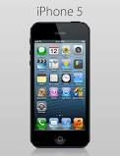

Slide 11
Iphone 5
Height=123.8mm
Width=7.6mm
Length=58.6mm
Work=123.8x 7.6x 58.8=
55135.568mm cubed

Slide 13
Giant Hershey Bar
Height= 5.5 in
Width=3.5 in
Length=0.3in
Work= 5.5 x 3.5 x 1=
19.25 in cubed

Slide 14
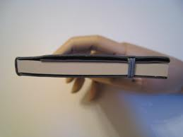

Slide 15
Notebook
Height= 10.5 cm
Length= 8 cm
Width= 3 cm
Work= 10.5 x 8 x 3=
252 cm cubed

Slide 16
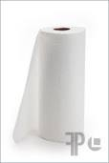

Slide 17
Paper Towel Roll
Height= 11 in
Radius= 5 in
Work= (11x11) x 3.14 x 5=
1899.7 in cubed

Slide 19
Dictionary
Height= 10 inches
Length= 8 inches
Width= 4 inches
Work= 10 x 8 x 4 =
320 inches cubed

Slide 20
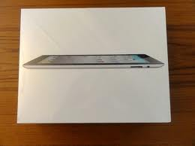

Slide 21
Ipad Box
Height= 10.1 inches
Length= 7 inches
Width= 1.9 inches
Work= 10.1in x 7in x 1.9in=
134.33 inches cubed

Slide 22
Scale Model- Dictionary
Real Size: 10 by 8 by 4 inches
Scale(divide by 2):
10 /2= 5in
8 /2=4in
4 /2= 2in
5x4x2 = 40inches cubed
2d sides – 6 rectangles

