Slide 1
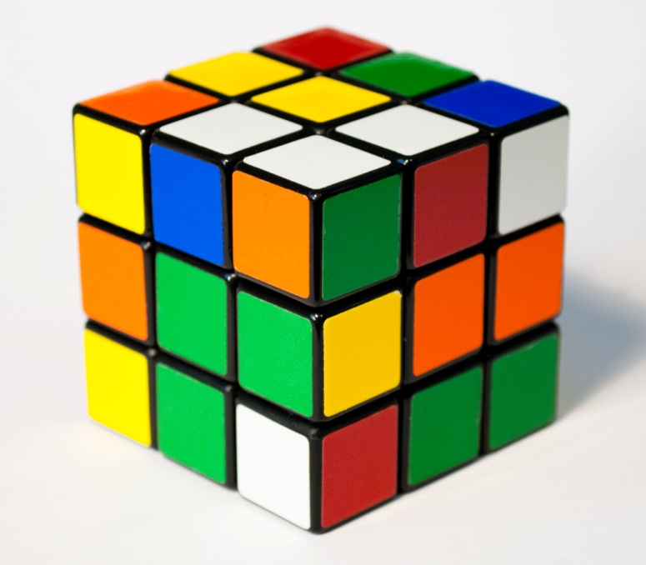
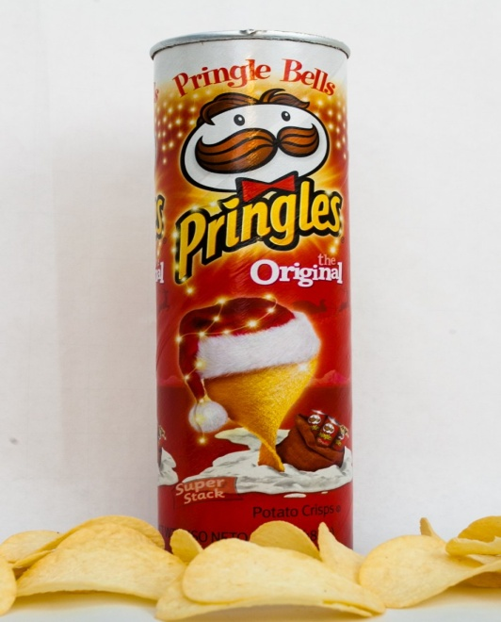
Everyday 3D Shapes
By: Henry Walburger, Anthony Capriotti, James DiGiacomo, and Jack Sypniewski

Slide 2
Lost Hero
W=19cm/ H=3cm/ L=13cm
FA=741cm3WORK/19x3x13=741

Slide 3
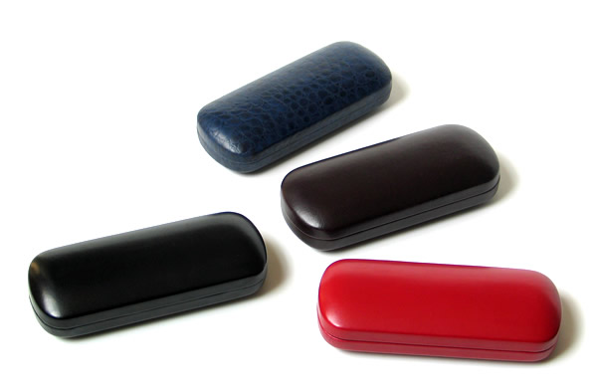
GLASSES CASE
L=6in/W=2in/L=1.5in
FA=18in3WORK/6x2x1.5=18

Slide 4
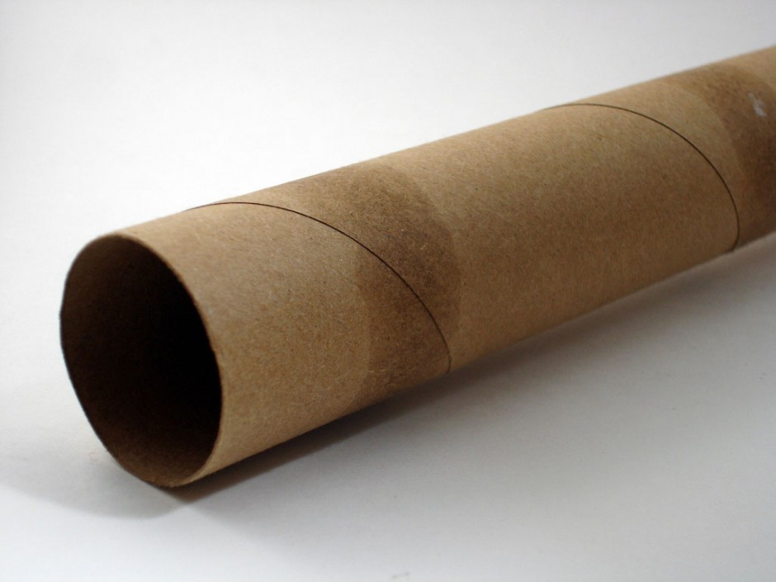
PAPER TOWEL ROLL
D=4cm/R=2cm/H=28cm
FA=351.7cm3WORK/2x3.14x28=351.7

Slide 5
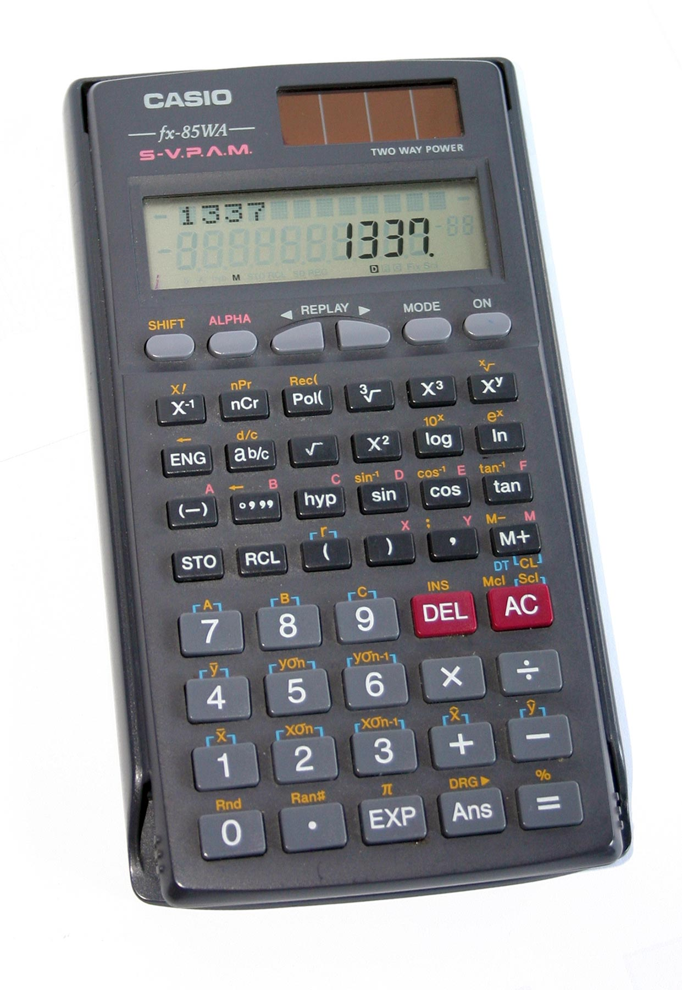
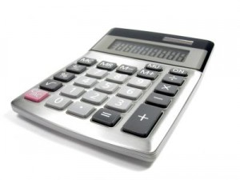
CALCULATOR
H=1cm/L=7cm/W=14cm
FA=98cm3WORK/1x7x14=98
Notes:
6

Slide 6
BOX
L=12cm/W=12cm/H=12
FA=1728cm3 WORK/12x12x12

Slide 7
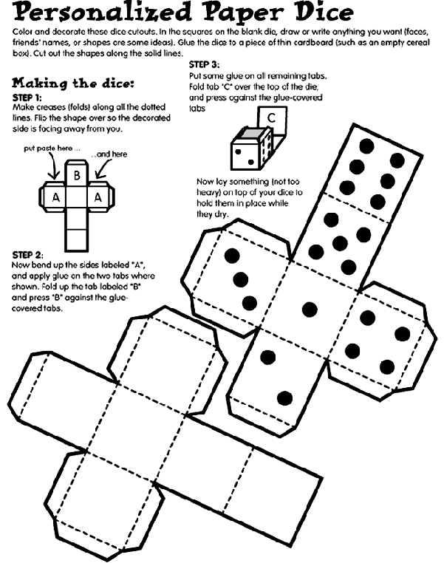
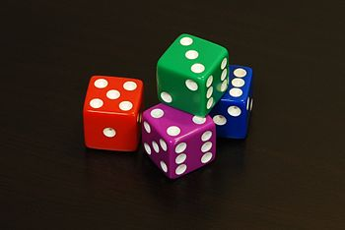
DICE
L=16mm/H=16mm/W=16mm
FA=4096mm3 WORK/16x16x16=4096

Slide 8
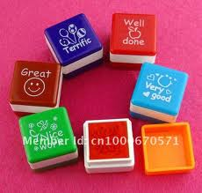
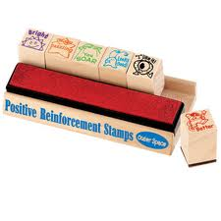
STAMP
L=2cm/H=2cm/W=2cm WORK/2x2x2=8
FA=8cm

Slide 9
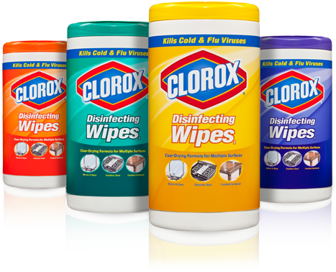
CLOROX WIPES
R=2in/H=8in WORK/2x2x3.14x8=100.48
FA=100.48in3

Slide 10
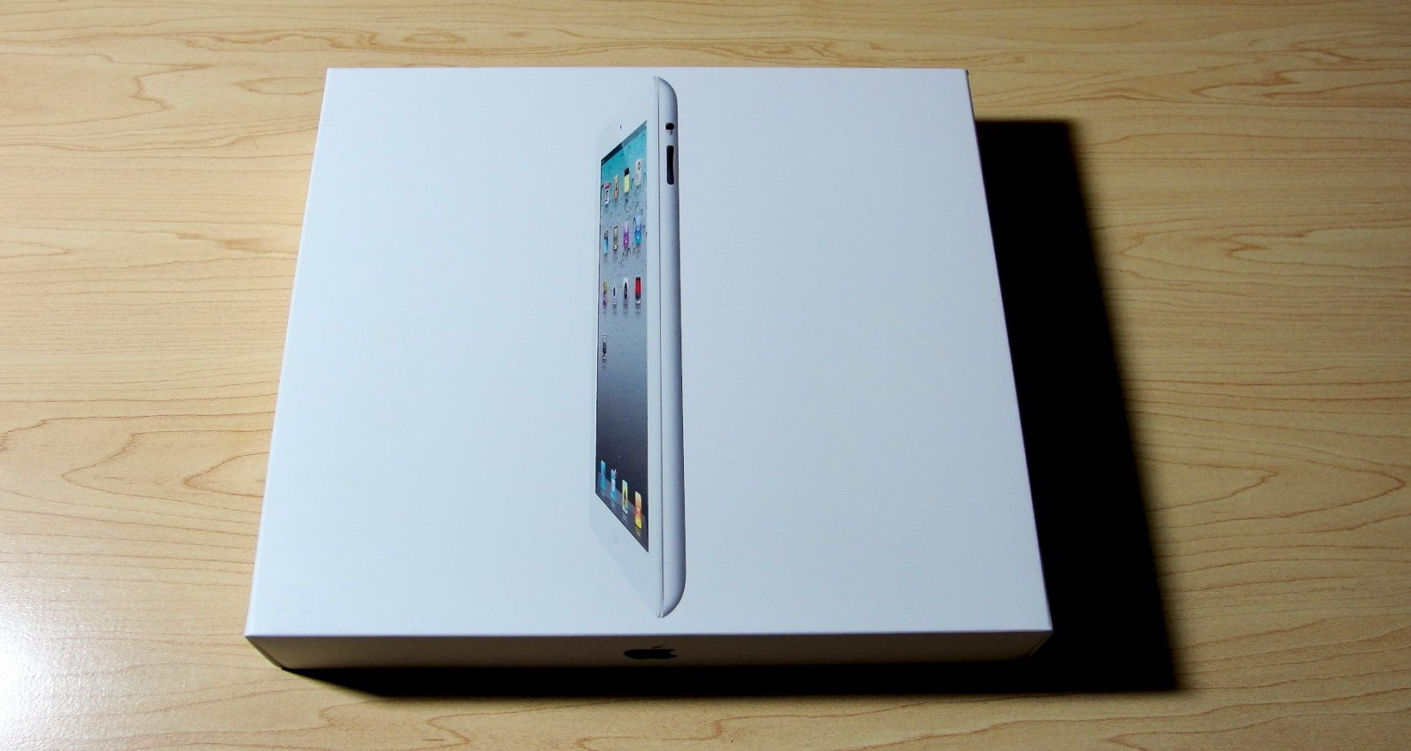
IPAD BOX
W=10in/H=2in/L=7.5in WORK/10x2x7.5=150
FA=150in3

Slide 11
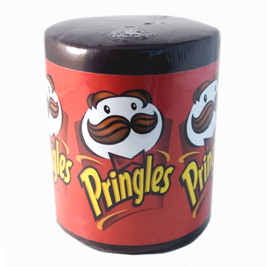
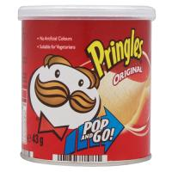
MINI PRINGLES
H=8cm/R=3.75 WORK/8x3.75x3.75x3.14=353.25
FA=353.25cm3

Slide 12
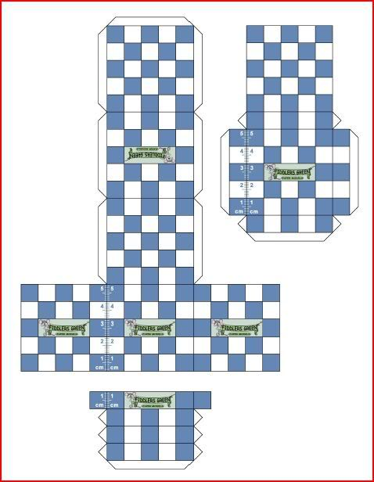
SCALE MODEL
OUR SCALE MODE=BOX/12cm=6cm
2cm=1cm

