Slide 1
GEOMETRIC SHAPES
By: Stephanie Trimarchi and Daniela Meeg
7-1
3-8-13

Slide 2
Plastic Cup
Shape- Cylinder
Diameter- 3 inches
Height- 6 inches
3.14×1.5×1.5×6= v= 42.39 inches

Slide 3
Tissue Box Holder
Shape- Rectangular Prism
Length- 10 inches
Width- 5 inches
Height- 4 inches
V= 10×5×4= 200 inches

Slide 4
Bracelet
Shape- Cylinder
Diameter- 3 inches
Height- 1.5 inches
3.14×1.5×1.5×1.5= v= 10.6 inches

Slide 5
Hermit Crab Cage
Diameter- 6 inches
Height- 6 inches
3.14×3×3×6= v= 169.56 inches

Slide 6
Coffee Table
Shape- Rectangular Prism
Length- 45 inches
Width- 24 inches
Height- 13.5 inches
45×24×13.5= v= 14,580 inches

Slide 7
Can Of Soup
Shape- Cylinder
Diameter- 3.5 inches
Height- 4.5 inches
3.14×1.75×1.75×4.5= v= 237.79 inches

Slide 8
Fish Tank
Shape- rect. prism
Length- 39.25 inches
Width- 10.5 inches
Height- 13 inches
39.25×10.5×13= v= 54,600 inches

Slide 9
Chicken Cage
Shape- rect. prism
Length- 39.25 inches
Width- 48 inches
Height- 25.5 inches
39.25×48×25.5= v= 48,042 inches

Slide 10
Tissue Box
Shape- cube
Length- 5 inches
Width- 5 inches
Height- 5 inches
5×5×5= v= 125 inches

Slide 11
iPad Box
Shape- rectangular prism
Length- 7.5 inches
Width- 10 inches
Height- 1.5 inches
7.5×10×1.5= v= 112.5 inches

Slide 12
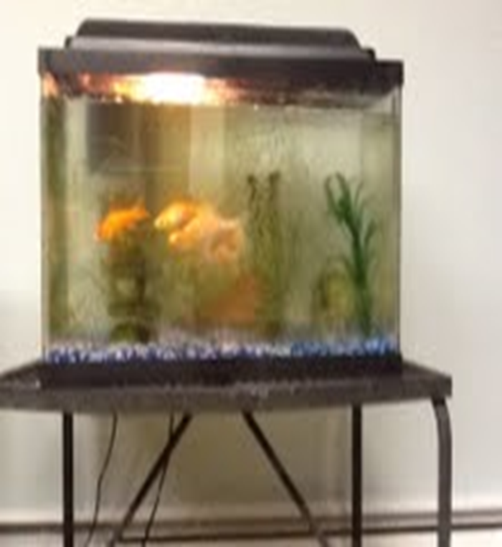
Scale Model
Our scale model was of the fish tank.
For every 2 centimeters was 1 centimeter.

