Slide 1
Chocolate Bar Selling Statistics
By: Steven Roberts, Nick O’Byrne, Justin Boyd

Slide 2
Paragraph
Nick, Justin and Steven were selling chocolate bars to see which type of chocolate bar would sell the most. Justin sold Hershey Chocolate Bars, Nick sold Milky Ways and Steven sold Twix Bars. They made 2$ for every chocolate bar they sold plus a 10 dollar salary for being a salesman (y=2x + 10).

Slide 3
Money Chart

Slide 4
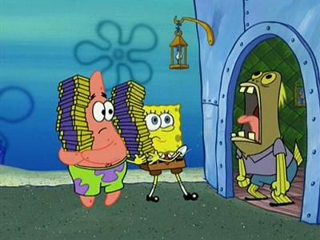
Conclusion
Justin sold the most chocolate bars, Nick came in second and Steven came in third. So, that means Hershey was the most popular chocolate bar, Milky Way bars were second and Twix bars were third.

Slide 5
THE END!!

