Slide 1
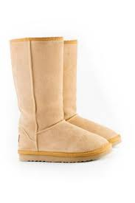
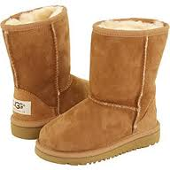
Ugg Australia VS. Designers For Less
We will be comparing the quantity of boots each company sells in the U.S. and how much money the companies earn.
Here to represent each company:
Tiana Machaalani: Ugg Australia representative/sales-woman
Olivia Meyer: Designers For Less representative/sales-woman

Slide 2
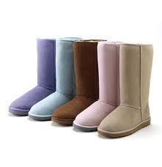
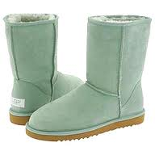
Each Pair of Boots is $200
Hi! My name is Tiana and I am a sales-woman from the company Ugg Australia! How many times have you ever bought those cheap knock off boots that only last a month because of the bad quality? Well, that won’t happen anymore. Here at Ugg Australia we make high quality boots that will last for many years. At the cheap knock off stores the prices may be lower than ours, but the boots won’t even last you one season. Yes, our boots are more expensive. But our boots have better quality and comfort for years. Buying our boots will be worth it, trust me! Once you buy a pair of Uggs, you will never by the knock offs again!

Slide 3
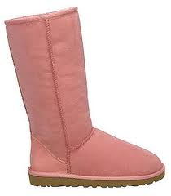
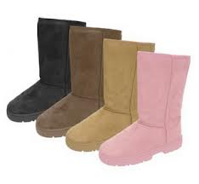
Designers For Less
Each Pair of Boots is only $50
Hi! My name is Olivia and I am a sales-woman from Designers For Less. What I am here to talk about is our boots. Most people love buying Ugg boots, but don’t like the price. After all, is $200 really worth it for a pair of boots? That’s why I am here today. What if I told you that you could have the same boots for a fraction of the price? ¼ to be exact. Designers For Less makes their own boots that look exactly like Uggs without the fancy label. We do amazing sales and make a large profit. So, you can save money on those comfy winter boots this season at Designers for Less!

Slide 4
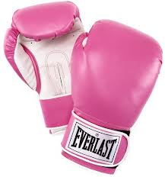
Designers For Less
Now that you know a little about each company, who do you think does better business? We have to check the data!
VS.

Slide 5
How many pairs of boots we sell in the U.S. in One Week From Sept.1st-7th, 2012
Days Companies Work | Ugg Australia-Tiana (x in function rule) | Designers For Less-Olivia (x in function rule)
MONDAY | 30 pairs of boots | 60 pairs of boots
TUESDAY | 20 pairs of boots | 20 pairs of boots
THURSDAY | 30 pairs of boots | 40 pairs of boots
FRIDAY | 50 pairs of boots | 120 pairs of boots
SATURDAY | 50 pairs of boots | 160 pairs of boots
SUNDAY | 40 pairs of boots | 100 pairs of boots
Ugg Australia:
y=$200x
Designers For Less:
y=$50x
Rules we will use to graph our data

Slide 6
Sales during the week of September 1st, 2012- September 7th, 2012 in the U.S.
Ugg Australia:
y=$200x
Amount of Money Companies Made in Dollars ($)
Days the Companies Work

Slide 7
Let’s Take A Closer Look
Based on this graph, it is pretty obvious that Ugg Australia makes more money. But, Designers for Less does better business, meaning that they have more customers. Let’s take a look at a line graph comparing the two companies average sales in the amount of boots that they sell per week.

Slide 8
Average Quantity of Boots Sold per Week From September 1^{st-}28th, 2012 in U.S.
AVERAGE NUMBER OF BOOTS SOLD
(Sept. 1st-7th) (Sept. 8th-14th)(Sept. 15th-21st)(Sept. 22nd-28th)
WEEKS

Slide 9
Both Ugg Australia and Designers For Less would like to thank all of you. The customers are what allow each company to do their business. Our companies have enjoyed coming here today to share with you some information that you may not have known. If you have any questions about anything you have seen today, just ask Tiana or Olivia. All calculations were based on each company’s sales over a certain period of time. Thank you again, and enjoy the rest of your day!

